Slide 1



SECOND REVIEW
Department of Computer Science and Engineering
22CSP72 PROJECT WORK II
Deep Learning-Based Tuberculosis Detection from Chest X-Ray Images
Team Number : A22
Team Guide : Dr. K. Venu
Team Members :
Abinandhana S G (23CSR008)
Anbuselvam N (23CSR018)
Gobika R (23CSR062)

Slide 2
PROBLEM STATEMENT
The existing CoAtNet-based tuberculosis detection framework performs automated classification using the entire chest X-ray image without explicitly isolating the lung region prior to classification.
The existing framework uses LIME for explainability, which provides local feature-based explanations but does not generate gradient-based class activation heatmaps for class-specific visualization of the model's predictions.
The existing framework does not provide an integrated AI-assisted diagnostic reporting mechanism that presents the model's prediction, prediction confidence, and explainability in a unified and structured format.

Slide 3
OBJECTIVES
Apply image preprocessing techniques, including resizing and Contrast Limited Adaptive Histogram Equalization (CLAHE), to enhance chest X-ray image quality.
Perform lung segmentation to isolate the lung region and reduce the influence of irrelevant background information.
Develop an CoAtNet-based deep learning framework for automated classification of chest X-ray images into Normal and Tuberculosis categories.
Integrate Grad-CAM++ to generate class-specific visual explanations for interpreting the model's predictions.
Develop an AI-assisted diagnostic reporting mechanism that presents the prediction, confidence score, and explainability results in a unified format.

Slide 4
LITERATURE SURVEY
S.No | Paper (Year) | Model Used | Performance | Limitations / Research Gap | Proposed Improvement
1 | Enhanced CoAtNet Based Hybrid Deep Learning Architecture for Automated Tuberculosis Detection in Human Chest X-rays (2025) | CoAtNet (CNN + Vision Transformer) + LIME | 86.39% Accuracy, 93.79% ROC-AUC | No lung segmentation, uses LIME, no diagnostic report | Integrate lung segmentation, Grad-CAM++, and AI-assisted diagnostic reporting.
2 | Ensemble Learning Based Automatic Detection of Tuberculosis in Chest X-ray Images Using Hybrid Feature Descriptors (2021) | Ensemble CNN + Gabor Features | AUC = 0.99 (Shenzhen), 0.97 (Montgomery) | Does not incorporate Explainable AI and lacks a Transformer-based architecture. | Introduce CoAtNet with Grad-CAM++ for improved feature learning and explainability.
3 | TB-CXRNet: Tuberculosis and Drug-Resistant Tuberculosis Detection Technique Using Chest X-ray Images (2024) | TB-CXRNet (CNN), CheXNet + MLP, Score-CAM | 93.32% (TB/Healthy), 87.48% (Drug-Resistant TB) | Relies mainly on CNN features, no hybrid CNN-Transformer, no lung segmentation | Use CoAtNet, lung segmentation, Grad-CAM++, and AI-assisted diagnostic reporting.
4 | Detecting Tuberculosis-Consistent Findings in Lateral Chest X-rays Using an Ensemble of CNNs and Vision Transformers (2024) | Ensemble CNN + Vision Transformer | 95.7% Accuracy | No Explainable AI, high computational complexity | Apply Grad-CAM++ and lung segmentation to improve model interpretability.
5 | Ensemble Deep Learning Architectures for Tuberculosis Detection (2026) | Ensemble CNN with Feature Fusion | AUC = 0.98 | High computational cost, lacks explainability | Use CoAtNet with Grad-CAM++ and AI-assisted diagnostic reporting.

Slide 5
RESEARCH GAP
Existing Enhanced CoAtNet-based models classify the entire chest X-ray image without incorporating lung segmentation to explicitly focus the analysis on the lung region.
The existing framework employs LIME for explainability, which provides local explanations but does not generate gradient-based class activation heatmaps for class-specific visualization of the model's predictions.
The reviewed studies apply lung segmentation, Enhanced CoAtNet, and Explainable AI independently rather than integrating these components into a unified end-to-end tuberculosis detection framework.
Automatic AI-assisted diagnostic report generation, integrating the prediction, confidence score, and explainability results, is not included in the existing Enhanced CoAtNet framework.

Slide 6
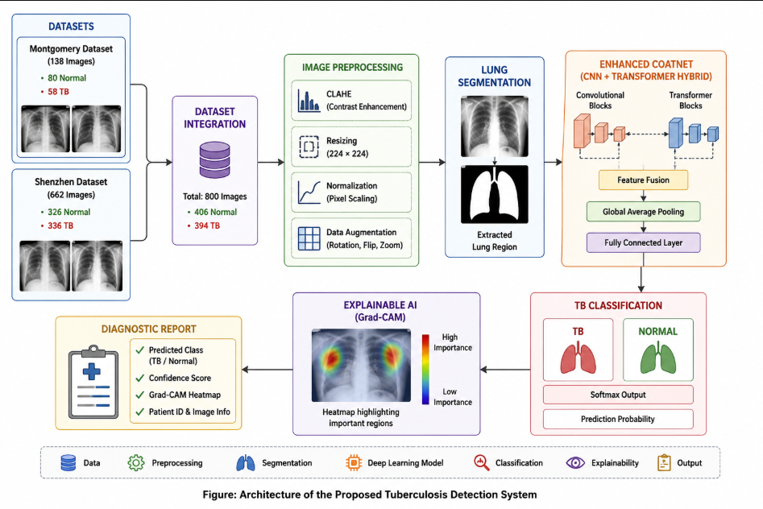
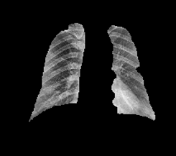
ARCHITECTURE DIAGRAM
CNN+VISION TRANSFORMER HYBRID
(Grad-CAM++)

Slide 7
PROPOSED WORK WITH PLANNED INNOVATION
Proposed Work
Apply image preprocessing (Resize and CLAHE).
Perform lung segmentation using TorchXRayVision.
Train the CoAtNet model for automated tuberculosis classification.
Generate Grad-CAM++ visualizations.
Generate an AI-assisted diagnostic report.
Planned Innovation
Combine lung segmentation and CoAtNet for lung-focused analysis.
Use Grad-CAM++ for class-specific visual explanations.
Combine prediction, confidence, and explainability in one diagnostic report.

Slide 8
MODULES OF THE PROJECT
Module 1: Image Preprocessing
Resize chest X-ray images to 512 × 512 pixels.
Apply CLAHE (Contrast Limited Adaptive Histogram Equalization) for contrast enhancement.
Generate preprocessed images for lung segmentation.
Module 2: Lung Segmentation
Use the pretrained TorchXRayVision lung segmentation model.
Load the model with its pretrained learned weights.
Pass the preprocessed chest X-ray through the segmentation network.
Generate pixel-wise probability maps for the lung regions.
Convert the probability maps into binary lung masks using a threshold.
Combine the lung regions to create the final lung mask.
Apply the mask to the chest X-ray to remove non-lung regions.
Generate the segmented lung image for further classification.

Slide 9
Module 3: Dataset Preparation and Data Augmentation
Organize the segmented lung images into Normal and Tuberculosis classes.
Split the dataset into Training, Validation, and Test sets.
Resize the images to 224 × 224 pixels for Enhanced CoAtNet.
Apply data augmentation only to the training images.
Use transformations such as rotation, translation, and scaling.
Combine original and augmented images to increase training data diversity.
Generate 559 augmented images, resulting in 1118 total training images.

Slide 10
Module 4: CoAtNet Model Training
Load the pretrained CoAtNet-0 (coatnet_0_rw_224) model.
Replace the original classifier head with a 2-class output layer for Normal and Tuberculosis.
Use segmented lung images resized to 224 × 224 pixels as input.
Train the model using the augmented training dataset.
Use CrossEntropyLoss with label smoothing (0.1) to calculate the classification loss.
Use the AdamW optimizer with a learning rate of 0.0001 and weight decay of 0.001.
Use the OneCycleLR learning rate scheduler during training.
Train the model for a maximum of 30 epochs with early stopping patience of 7 epochs.
Validate the model after each epoch using the validation dataset.
Save the best model based on validation performance.

Slide 11
Module 5: Tuberculosis Classification and Model Evaluation
Load the best trained CoAtNet model for testing and prediction.
Provide the 224 × 224 segmented lung images as input to the model.
Generate prediction scores for the Normal and Tuberculosis classes.
Apply Softmax to convert the prediction scores into class probabilities.
Select the class with the highest probability as the final prediction.
Calculate the prediction confidence for the predicted class.
Evaluate the model using the test dataset.
Measure performance using Accuracy, Precision, Recall, F1-Score, and ROC-AUC.
Generate the Classification Report, Confusion Matrix, and ROC Curve.

Slide 12
Module 6: Grad-CAM++ Visualization and AI-Assisted Diagnostic Reporting
Load the trained CoAtNet model and the input chest X-ray image.
Perform prediction to identify the Normal or Tuberculosis class and its confidence score.
Select the appropriate target layer from the CoAtNet model.
Compute the gradients and feature maps for the predicted target class.
Calculate Grad-CAM++ importance weights from the feature maps and gradients.
Generate a class-specific activation heatmap showing the regions that influenced the prediction.
Resize and overlay the Grad-CAM++ heatmap on the input chest X-ray image for visual interpretation.
Generate an AI-assisted diagnostic report containing the predicted class, confidence score, and Grad-CAM++ visualization.

Slide 13
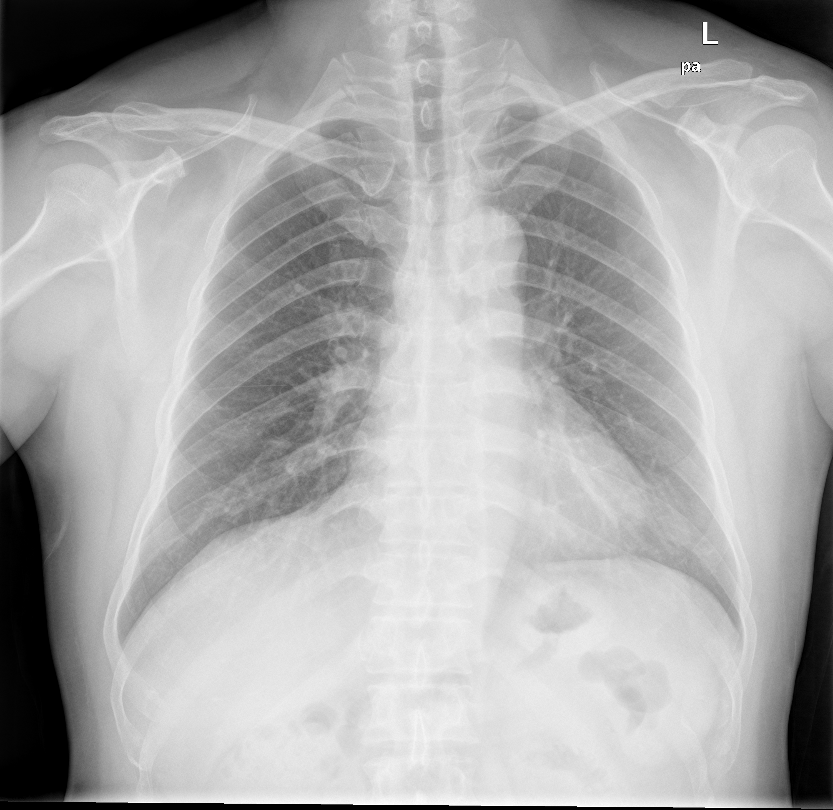
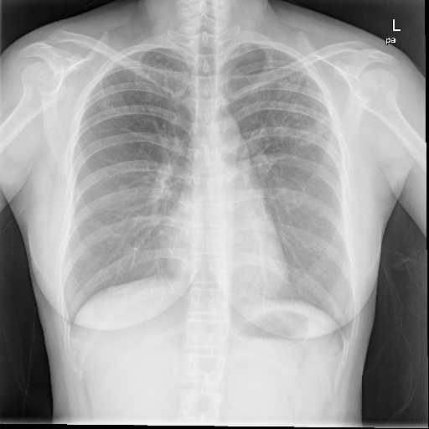
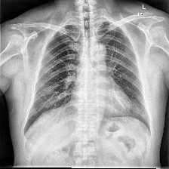
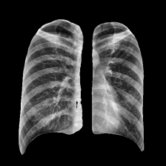
IMPLEMENTATION
Original Image Resized (512 × 512) Image CLAHE Enhanced Image(512×512) Segmented Lung Image(224×224)

Slide 14
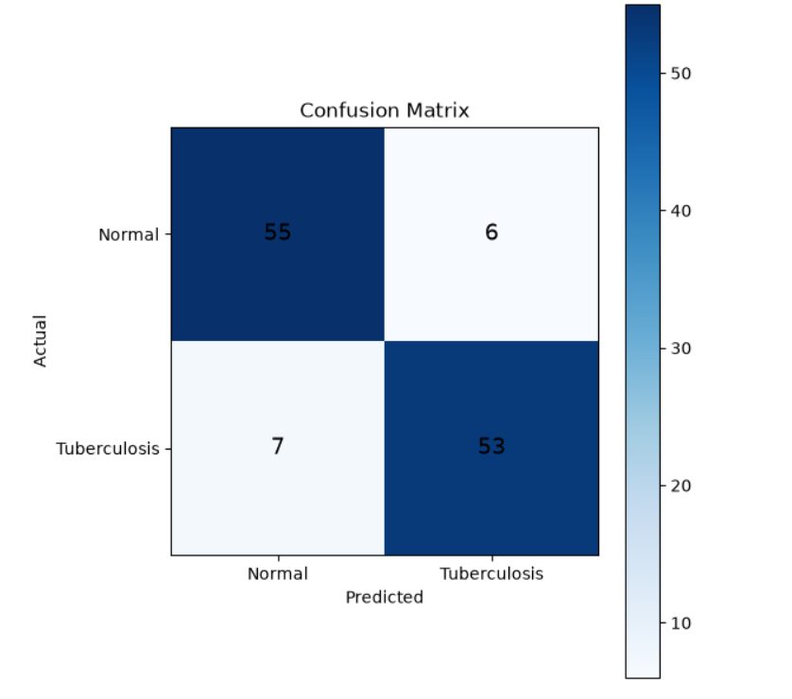
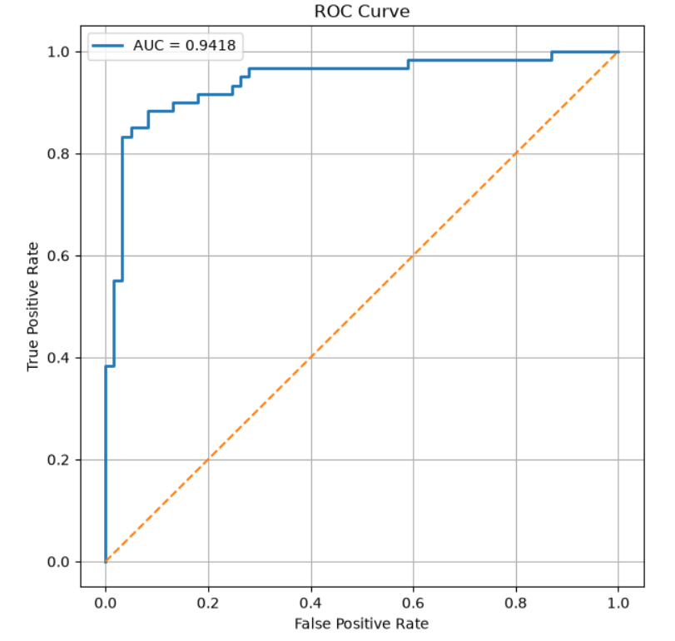

Slide 15
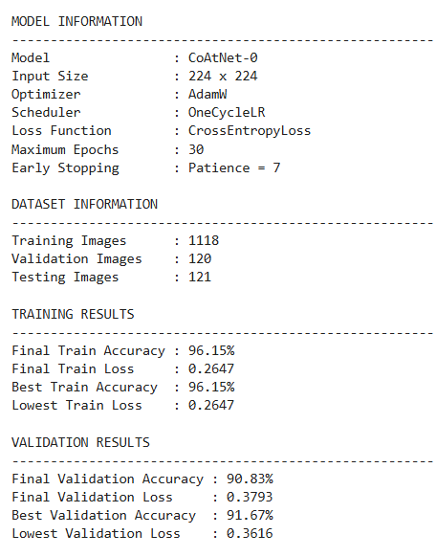
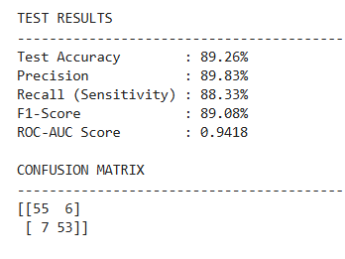

Slide 16
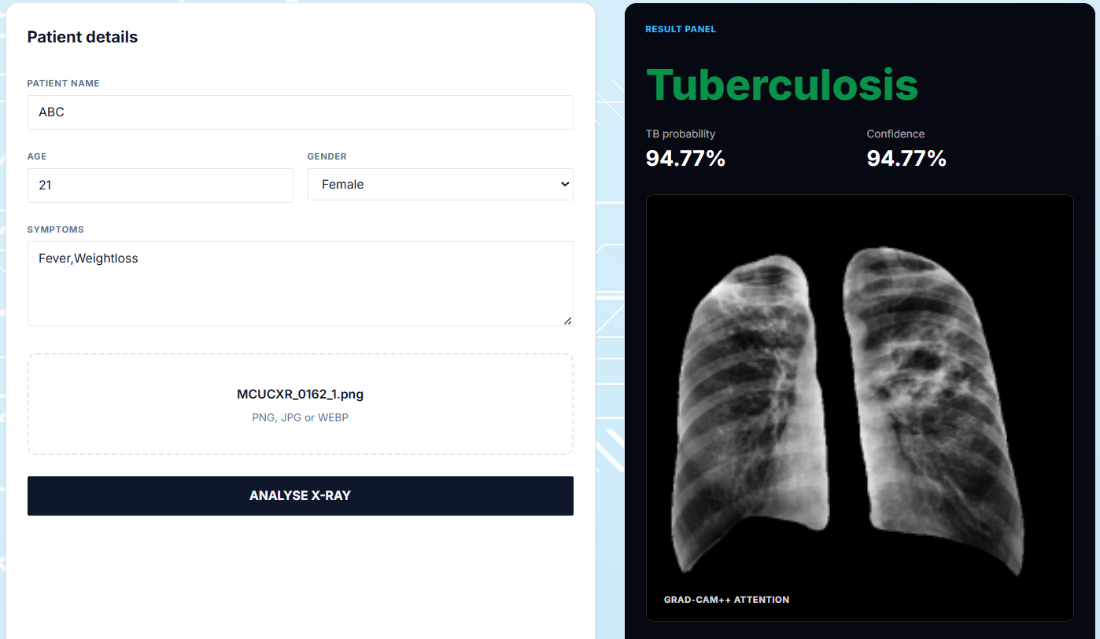

Slide 17
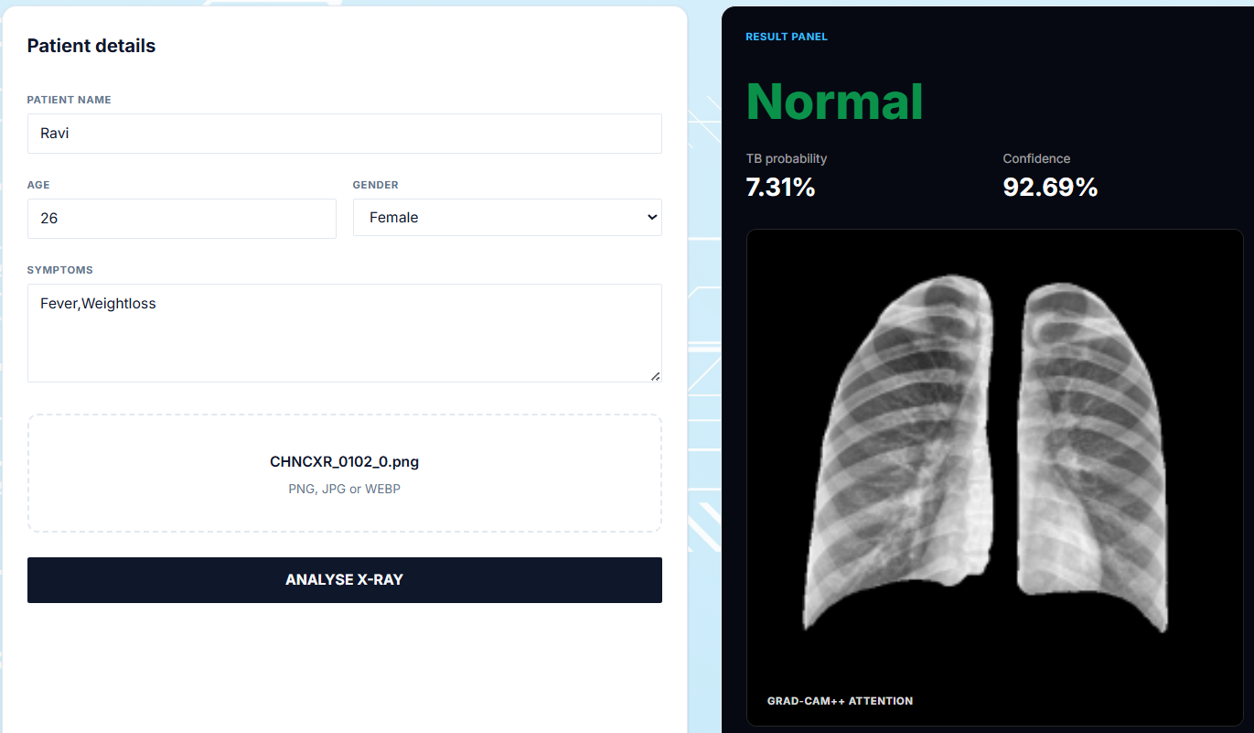

Slide 18
BASE LINE COMPARISION
Feature / Component | Existing / Baseline System | Proposed System
Input | Chest X-ray | Chest X-ray + Genomic Information
CXR Model | DEiT-B/16 | CoAtNet-0
Genomic Model | Not used | Transformer
Fusion | Not used | Late Fusion
Classification | DR-TB vs DS-TB | DR-TB vs DS-TB
Precision | 0.826 | 97.92%
Recall / Sensitivity | 0.828 | 92.16%
F1-Score | 0.827 | 94.95%
ROC-AUC | 0.800 | 0.9714
Accuracy | Not reported | 93.69%
Interpretability | Local feature-based explanation | Class-specific visual explanation
Diagnostic Support | Limited | Enhanced with visual and structured reporting

Slide 19
COMPLEXITY & COST
Aspect | Proposed System
Computational Complexity | Uses lung segmentation, CoAtNet-0, genomic Transformer, and multimodal fusion, resulting in higher computational requirements during training.
Implementation Complexity | Involves multiple stages including CXR preprocessing, lung segmentation, CXR classification, genomic processing, multimodal fusion, explainability, and report generation.
Hardware Cost | Model training may require GPU resources due to CoAtNet-0, Transformer processing, and multimodal training.
Development Cost | Uses open-source deep learning frameworks and pretrained models such as CoAtNet-0 and TorchXRayVision, reducing software and licensing costs.
Operational Cost | After training, the system can automate CXR, genomic, and multimodal predictions with explainability, reducing repeated manual analysis.

Slide 20
RELEVANCE TO ENVIRONMENT & SUSTAINABILITY
Relevance to Environment
Supports paperless digital diagnosis.
Reduces unnecessary manual processing and resource usage.
Sustainability
Scalable and reusable for large-scale TB screening.
Low operational cost after model development.
SDG Goal Mapping
SDG 3 – Good Health and Well-being
The proposed AI-based Tuberculosis detection system analyzes Chest X-ray images using deep learning to support early and automated identification of Tuberculosis, contributing to improved diagnostic support and better healthcare outcomes.

Slide 21
THANK YOU

